Slide 1



NSEBOT: AUTOMATED
REPORT RETRIEVAL
Mentor: Mr. Durga prasad
Coordinator: Ms. Thavayee
1

Slide 2


PROBLEM STATEMENT
Manual Download
Currently, NSE reports are downloaded manually, leading to errors, inefficiencies, and potential data loss.
Data Integrity
Manual download processes lack robust duplicate handling and format validation, affecting data consistency.

Slide 3
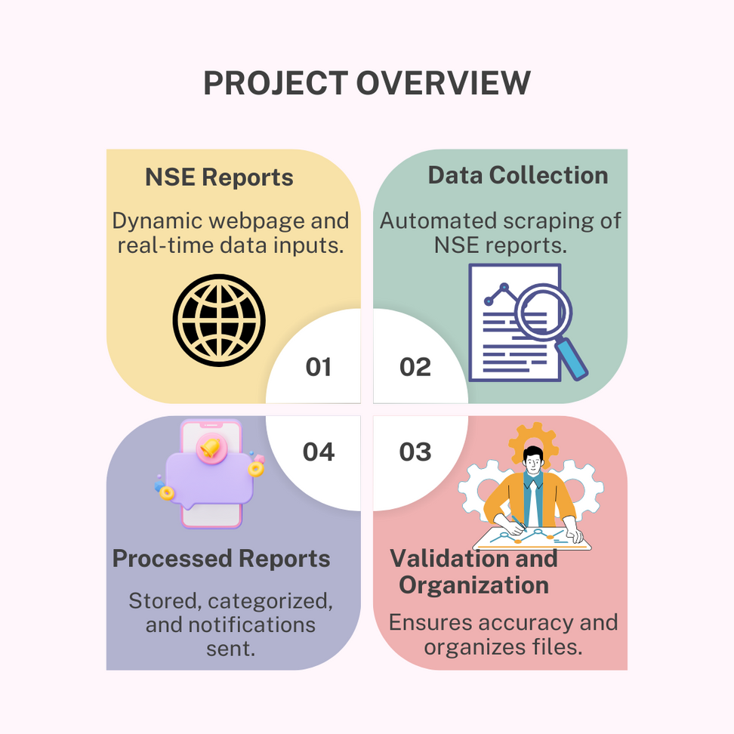



PROJECT OVERVIEW
NSEBot
1
Automated report retrieval system
Data Retrieval
2
Securely downloads reports
Duplicate Handling
3
Ensures unique reports
Error Handling
4
Manages download failures
Report Management
5
Organizes and notifies

Slide 4




TECHNICAL STACK
PYTHON
SELENIUM
STREAMLIT
SMTPLIB
Core programming language for automation
Data retrieval and analysis library
Web framework for API development
Execution of the mail in NSE Bot

Slide 5
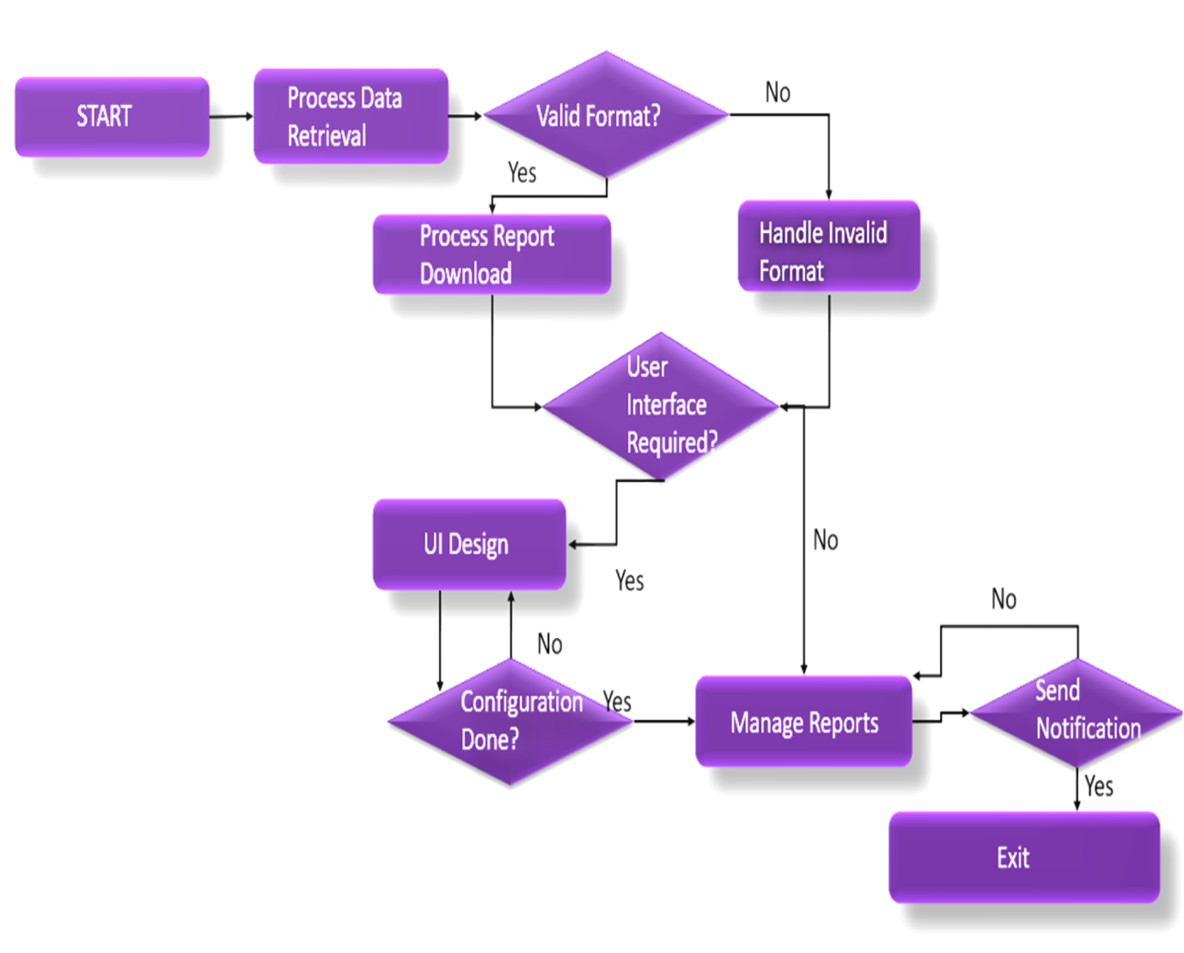

PROCESS
FLOWCHART

Slide 6


CHALLENGES AND SOLUTIONS
1
NSE API
Limited documentation and potential changes
2
DATA FORMAT CONSISTENCY
Validation and error handling for CSV format
3
ERROR RESILIENCE
Automatic retries and error logging
4
SECURITY AND PRIVACY
Secure authentication and data handling

Slide 7
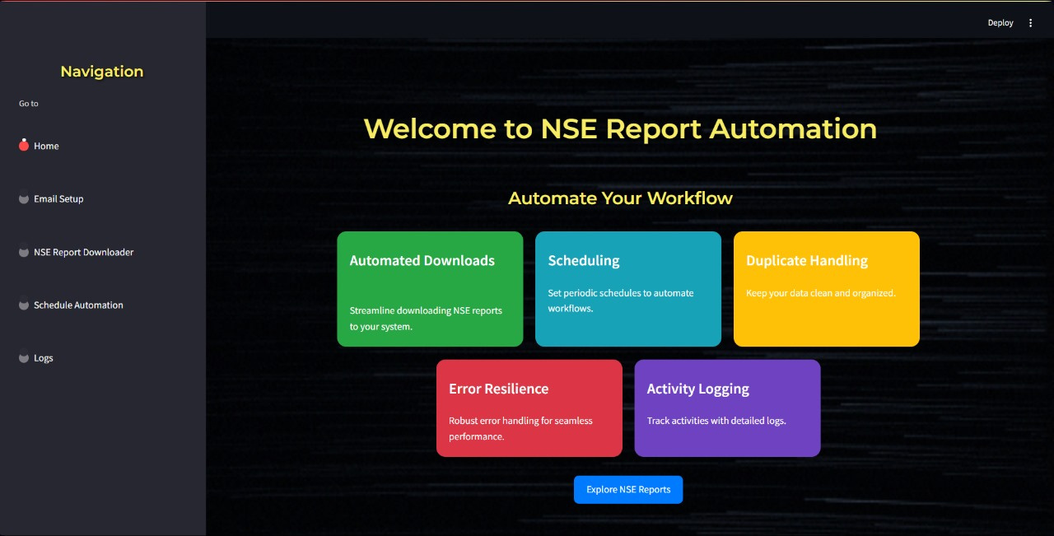
KEY FEATURES
Automated Download
Duplicate Handling
Regularly retrieves reports based on schedule
Identifies and manages duplicate
reports
Error Logging and Reporting
Tracks and informs about download failures
Report Management
Organizes and stores reports in a
structured manner

Slide 8

FUTURE SCOPE
The future scope of the NSE Automated Downloading Report Bot includes expanding its capabilities to other financial markets and integrating advanced analytics for deeper insights.
Enhancing the user interface with customizable dashboards and ensuring the system's scalability and robust security measures will further improve user experience and data protection.

Slide 9

CONCLUSION
The NSE Automated Downloading Report Bot enhances efficiency and accuracy in retrieving and organizing reports.
By automating tasks and providing real-time notifications, it ensures timely access to critical data and reduces manual effort.
This project significantly improves productivity and decision-making for stakeholders.

